Slide 1
Lecture 7:
Neural Networks part 3

Slide 2
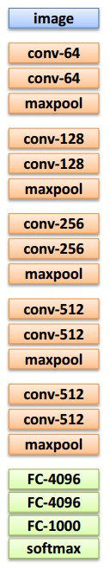
Transfer Learning with CNNs
1. Train on
ImageNet
2. If small dataset: fix all weights (treat CNN as fixed feature extractor), retrain only the classifier
i.e. swap the Softmax layer at the end
3. If you have medium sized dataset, “finetune” instead: use the old weights as initialization, train the full network or only some of the higher layers
retrain bigger portion of the network, or even all of it.

Slide 3
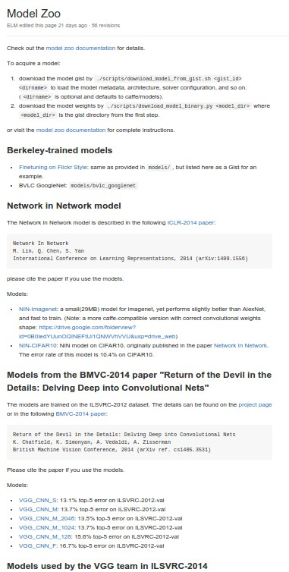
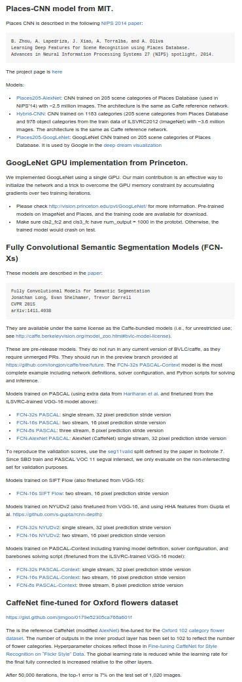
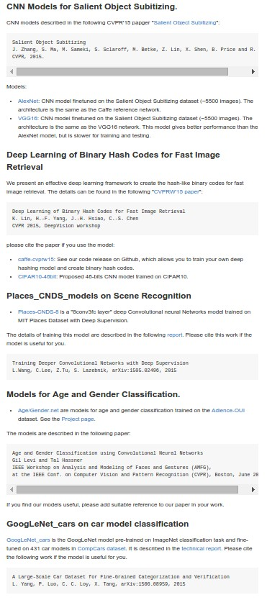
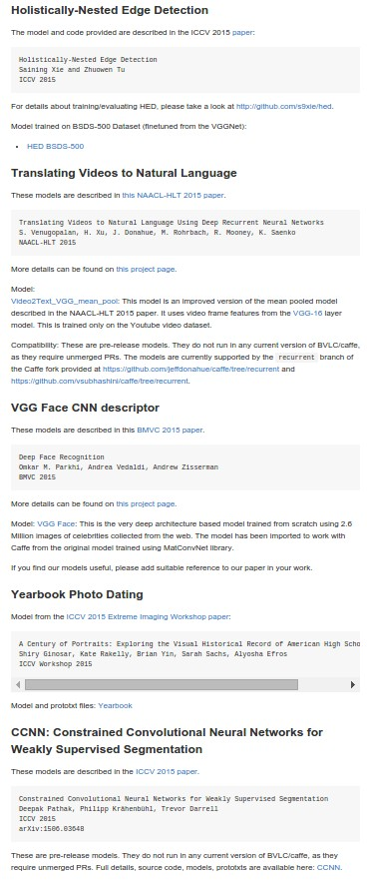
E.g. Caffe Model Zoo: Lots of pretrained ConvNets
https://github.com/BVLC/caffe/wiki/Model-Zoo
...

Slide 4
Where we are now...
Mini-batch SGD
Loop:
Sample a batch of data
Forward prop it through the graph, get loss
Backprop to calculate the gradients
Update the parameters using the gradient

Slide 5
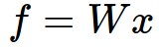
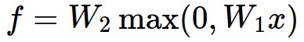
Neural Network: without the brain stuff
(Before) Linear score function:
(Now) 2-layer Neural Network
or 3-layer Neural Network

Slide 6


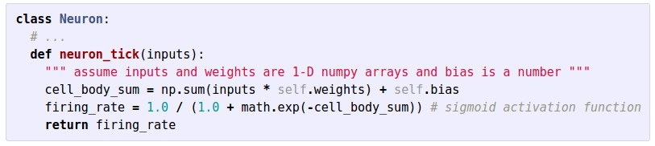

Slide 7


Neural Networks: Architectures
“3-layer Neural Net”, or
“2-hidden-layer Neural Net”
“2-layer Neural Net”, or
“1-hidden-layer Neural Net”
“Fully-connected” layers

Slide 8
Training Neural Networks
A bit of history...

Slide 9
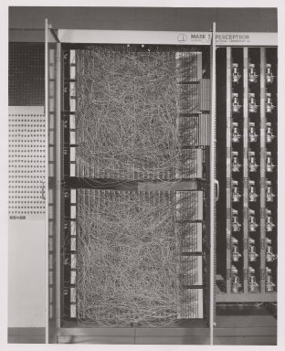
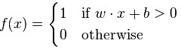
A bit of history
The Mark I Perceptron machine was the first implementation of the perceptron algorithm.
The machine was connected to a camera that used 20×20 cadmium sulfide photocells to produce a 400-pixel image.
recognized
letters of the alphabet
update rule:
Frank Rosenblatt, ~1957: Perceptron

Slide 10
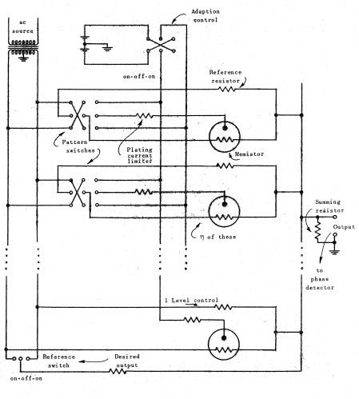
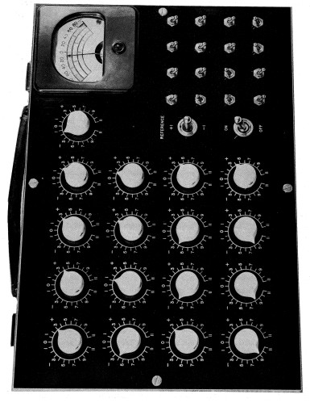
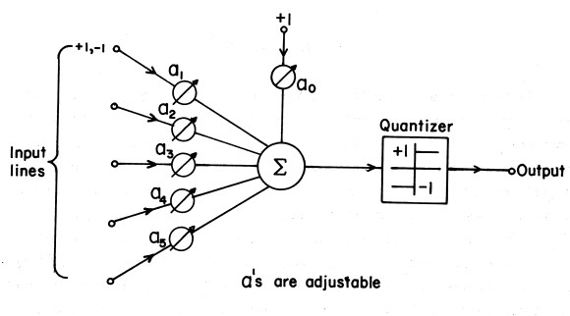
A bit of history
Widrow and Hoff, ~1960: Adaline/Madaline

Slide 11
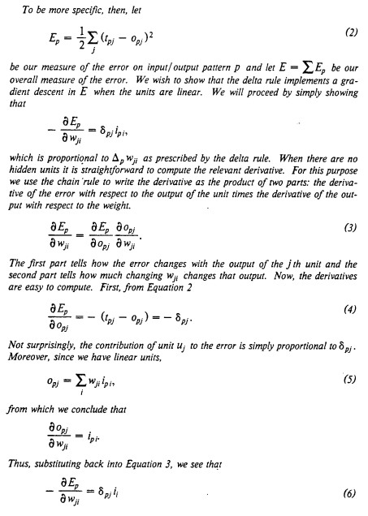
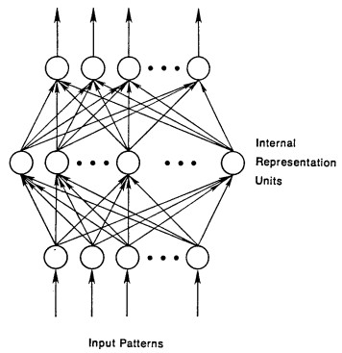
A bit of history
recognizable maths
Rumelhart et al. 1986: First time back-propagation became popular

Slide 12
Schmidhuber’s page on history of BP
http://people.idsia.ch/~juergen/who-invented-backpropagation.html

Slide 13
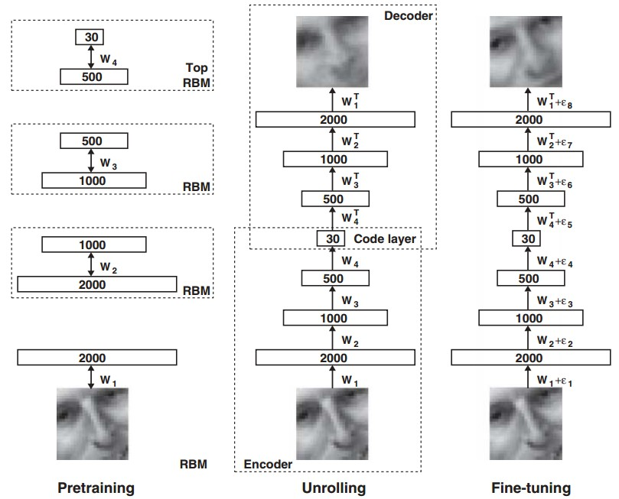
A bit of history
[Hinton and Salakhutdinov 2006]
Reinvigorated research in Deep Learning
NOT NEURAL NETWORKS!

Slide 14
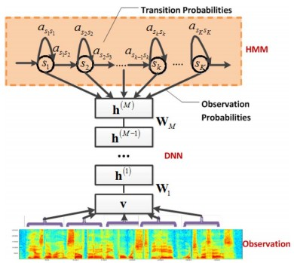
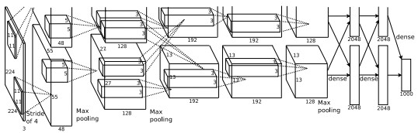
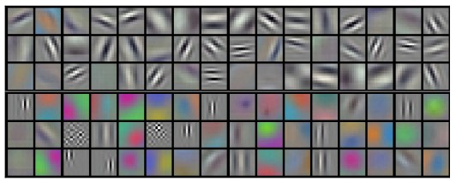
First strong results
Context-Dependent Pre-trained Deep Neural Networks
for Large Vocabulary Speech Recognition
George Dahl, Dong Yu, Li Deng, Alex Acero, 2010
Imagenet classification with deep convolutional
neural networks
Alex Krizhevsky, Ilya Sutskever, Geoffrey E Hinton, 2012

Slide 15
First strong results
Imagenet classification with deep convolutional
neural networks
Alex Krizhevsky, Ilya Sutskever, Geoffrey E Hinton, 2012
Dropout training and ReLU’s...

Slide 16
Overview
One time setup
activation functions, preprocessing, weight initialization, regularization, gradient checking
Training dynamics
babysitting the learning process,
parameter updates, hyperparameter optimization
Evaluation
model ensembles

Slide 17
Activation Functions

Slide 18
Activation Functions

Slide 19
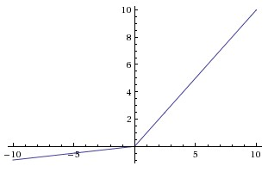
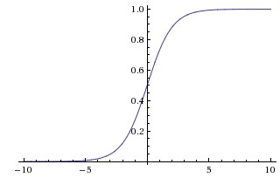
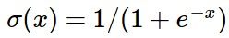
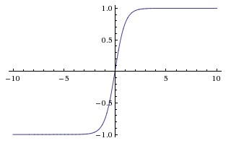
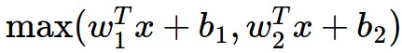
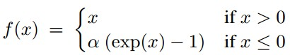
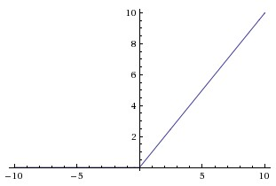
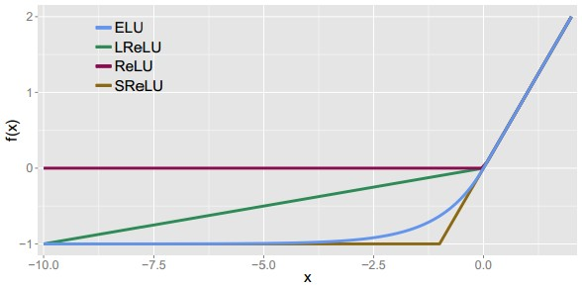
Activation Functions
Leaky ReLU
max(0.1x, x)
Sigmoid
Maxout
tanh tanh(x)
ELU
ReLU max(0,x)

Slide 20
Activation Functions
Squashes numbers to range [0,1]
Historically popular since they have nice interpretation as a saturating “firing rate” of a neuron
Sigmoid

Slide 21
Activation Functions
Squashes numbers to range [0,1]
Historically popular since they have nice interpretation as a saturating “firing rate” of a neuron
3 problems:
Saturated neurons “kill” the gradients
Sigmoid

Slide 22
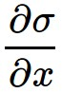
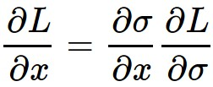
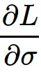
sigmoid
gate
x
What happens when x = -10?
What happens when x = 0?
What happens when x = 10?

Slide 23
Activation Functions
Squashes numbers to range [0,1]
Historically popular since they have nice interpretation as a saturating “firing rate” of a neuron
3 problems:
Saturated neurons “kill” the gradients
Sigmoid outputs are not zero-centered
Sigmoid

Slide 24
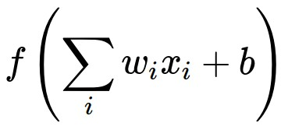
Consider what happens when the input to a neuron (x)
is always positive:
What can we say about gradients with respect to w?

Slide 25
Consider what happens when the input to a neuron is always positive...
allowed gradient update directions
zig zag path
allowed gradient update directions
hypothetical optimal w vector
What can we say about the gradients on w?
Always all positive or all negative :(
(this is also why you want zero-mean data!)

Slide 26
Activation Functions
Squashes numbers to range [0,1]
Historically popular since they have nice interpretation as a saturating “firing rate” of a neuron
3 problems:
Saturated neurons “kill” the gradients
Sigmoid outputs are not zero-centered
exp() is a bit compute expensive
Sigmoid

Slide 27
Activation Functions
Squashes numbers to range [-1,1]
zero centered (nice)
still kills gradients when saturated :(
tanh(x)
[LeCun et al., 1991]

Slide 28
Activation Functions
Computes f(x) = max(0,x)
Does not saturate (in +region)
Very little computation
Converges much faster than sigmoid/tanh in practice (e.g. 6x)
ReLU
(Rectified Linear Unit)
[Krizhevsky et al., 2012]

Slide 29
Activation Functions
Computes f(x) = max(0,x)
Does not saturate (in +region)
Very computationally efficient
Converges much faster than sigmoid/tanh in practice (e.g. 6x)
Not zero-centered output
An annoyance:
hint: what is the gradient when x < 0?
ReLU
(Rectified Linear Unit)

Slide 30
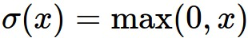
ReLU
gate
x
What happens when x = -10?
What happens when x = 0?
What happens when x = 10?

Slide 31
DATA CLOUD
active ReLU
dead ReLU
will never activate
=> never update

Slide 32
DATA CLOUD
active ReLU
=> people like to initialize ReLU neurons with slightly positive biases (e.g. 0.01)
dead ReLU
will never activate
=> never update

Slide 33
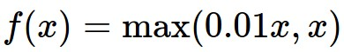
Activation Functions
[Mass et al., 2013]
[He et al., 2015]
Does not saturate
Computationally efficient
Converges much faster than sigmoid/tanh in practice! (e.g. 6x)
will not “die”.
Leaky ReLU

Slide 34
Activation Functions
Make up your own parametric rectifier! (Project idea!!!)
How about shifting the hinge?
How about shifting the slope?
How about changing the shape of the right side?
How about a diversity of ReLU’s. What are pros and cons?
Leaky ReLU

Slide 35
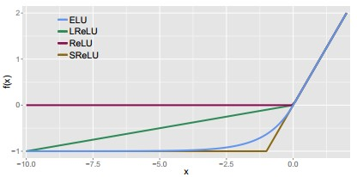
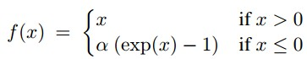
Activation Functions
[Clevert et al., 2015]
Exponential Linear Units (ELU)
Most benefits of ReLU
Does not die
Closer to zero mean outputs
Computation requires exp()

Slide 36
Maxout “Neuron”
Does not have the basic form of dot product -> nonlinearity
Generalizes ReLU and Leaky ReLU
Linear Regime! Does not saturate! Does not die!
[Goodfellow et al., 2013]
Problem: doubles the number of parameters/neuron :(

Slide 37
TLDR: In practice:
Use ReLU. Be careful with your learning rates
Try out Leaky ReLU / Maxout / ELU
Try out tanh but don’t expect much
Don’t use sigmoid

